Slide 1
ELEMENTARY STATISTICS, BLUMAN
TI Calculator - Confidence Interval for a Proportion
© 2019 McGraw-Hill Education. All rights reserved. Authorized only for instructor use in the classroom. No reproduction or further distribution permitted without the prior written consent of McGraw-Hill Education.

Slide 2
Objectives for this PowerPoint
How to use the TI Graphing Calculator to construct a confidence interval estimate of a population proportion
How to find the margin of error using the interval endpoints

Slide 3
Problem
In a random sample of 250 days in the state of California, the average ambient concentration of benzene was greater than 3.7 micrograms per cubic meter on 71 of those days. Find the 90% confidence interval estimate for the population proportion of days in California where the average ambient concentration of benzene is greater than 3.7 micrograms per cubic meter.

Slide 4
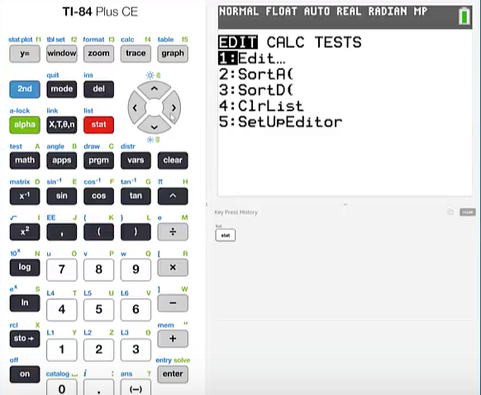
TI Graphing Calculator (1)
In order to use the TI graphing calculator to find the interval endpoints for a confidence interval estimate of a population proportion, we should begin by pushing stat
cursor over to TESTS

Slide 5
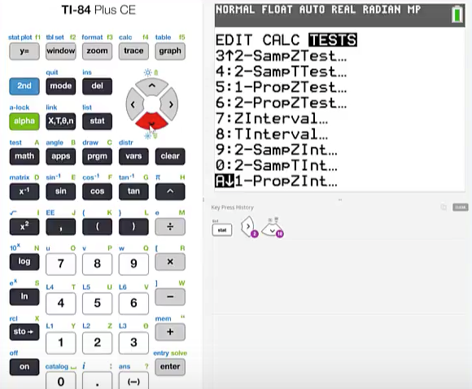
TI Graphing Calculator (2)
Cursor down until we get to A:1-PropZInt…
Press enter

Slide 6
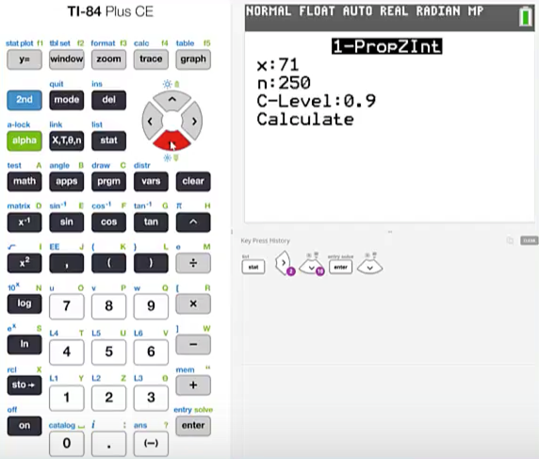
TI Graphing Calculator (3)
x are number of successes with 71
n the number of observations was 250
Confidence level is 0.9 or 90%
Highlight Calculate and then press enter

Slide 7
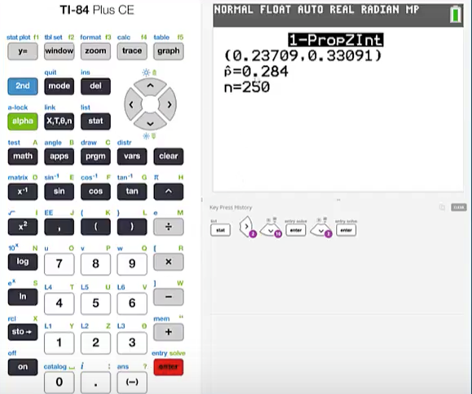
TI Graphing Calculator (4)
Our interval endpoints are 0.237 and 0.331.
Note also that the sample proportion of 0.284 is given.

Slide 8
Interpretation
Our interpretation of the interval would be:
It can be stated with 90% confidence that the population proportion of days in California where the average ambient concentration of benzene is greater than 3.7 micrograms per cubic meter is between 0.237 and 0.331 when we round to three decimal places.
Recall that a confidence interval is constructed by beginning with the point estimator. Then add the margin of error to find the right endpoint and then subtract the margin of error to find the left endpoint.

Slide 9
Margin of Error
The margin of error can be determined by dividing the interval width by 2. We can calculate the margin of error for this interval by subtracting the left endpoint from the right endpoint and then dividing by 2. This gives us a margin of error of 0.047.
With 95% confidence our estimate is within 4.7% of the true proportion.

Slide 10
Summary
In this PowerPoint, we learned how to calculate the interval endpoints of a confidence interval estimate for a population proportion using the TI graphing calculator.

